Slide 1

END TO END PROJECT
Problem statement ID : SIH1734
Problem Statemebt Title: Downscaling of satellite-based air quality map using AI/ML
PROJECT TEAM:
1. Ps. Chandana - 22BQ1A42C0
2. SK. Rihana - 22BQ1A42E9
3. S. Bhavana - 22BQ1A42E8
4. SK. Hamida - 22BQ1A42D6

Slide 2
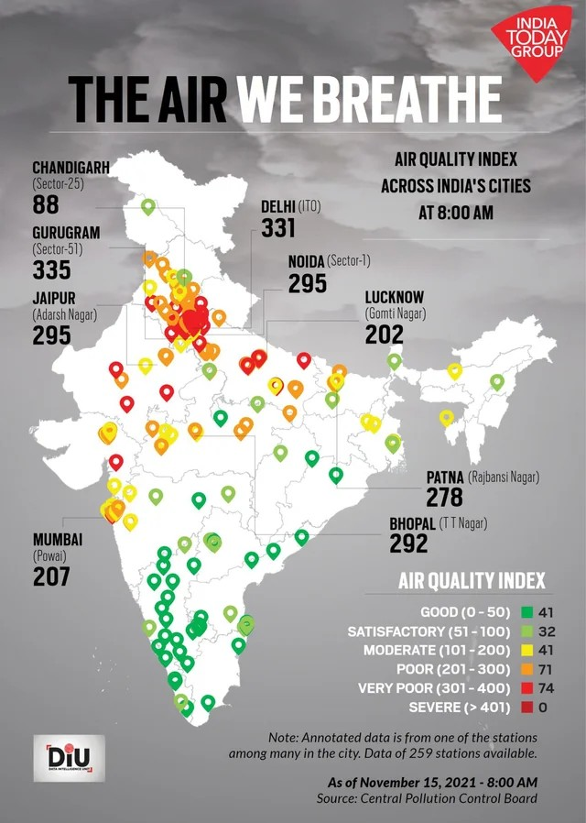
An AI/ML model generates fine-resolution NO2 air quality maps from coarse satellite data, validating accuracy with independent datasets for enhanced assessment.

Slide 3
PROPOSED SOLUTION
Data Acquisition:
Collect coarse-resolution satellite data on NO2 levels, addressing gaps from cloudy conditions.
Preprocessing:
Clean and interpolate data using Python libraries.

Slide 4
Model Selection: Choose optimal ML algorithms for spatial interpolation.
Validation: Test model accuracy with independent datasets.
Visualization: Generate high-resolution air quality maps for assessments.

Slide 5
Challenges and Risks
Data Quality: Inconsistent data affects model performance.
Validation Issues: Ensuring accuracy with diverse independent data is challenging.
Infrequent satellite observations may not capture rapid changes in air quality, impacting model accuracy.

Slide 6
BENEFITS
Public Health: Supports better health outcomes through timely data.
Environmental Benefits: Promotes proactive pollution management and cleaner air.
Economic Efficiency: Reduces healthcare costs and resource allocation.
Resource Optimization: Efficiently utilizes data for better management.

